Slide 1
Post Christmas break meeting
Beam equation,
Pre-processing wavelets
Next steps?

Slide 2
Beam equation
Getting the wavelet transform
Observing 1:3 modes

Slide 3
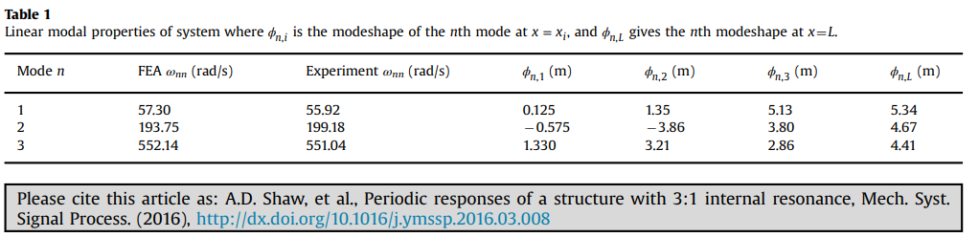
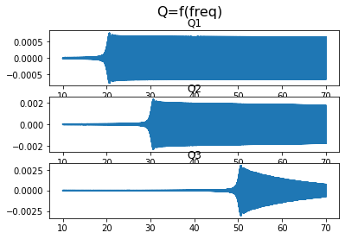
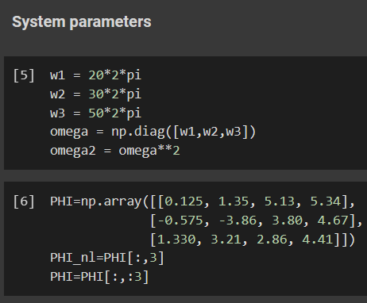
Changed omega

Slide 4
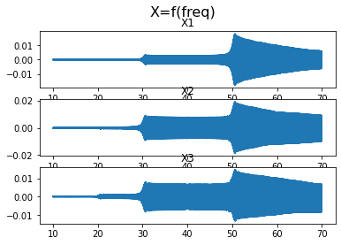

Weak influence from w1

Slide 5
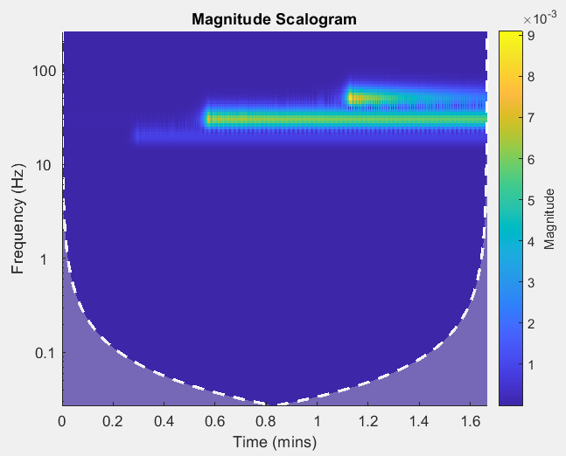
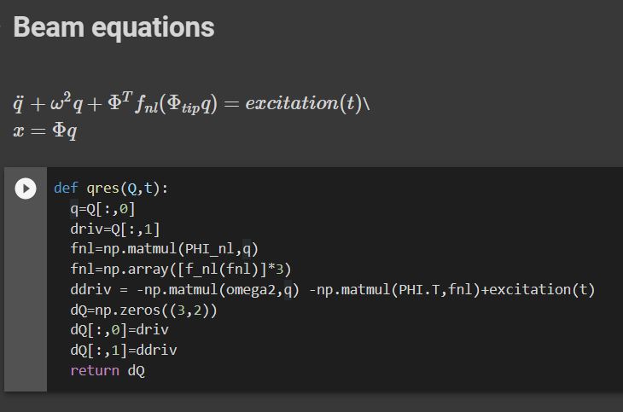
Wavelet transform X3
No damping

Slide 6
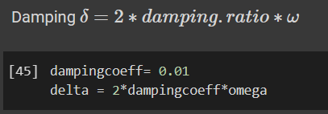
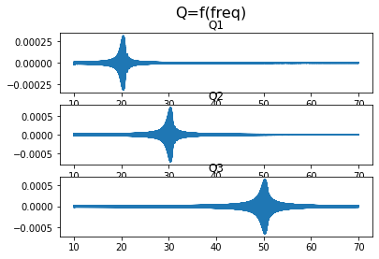
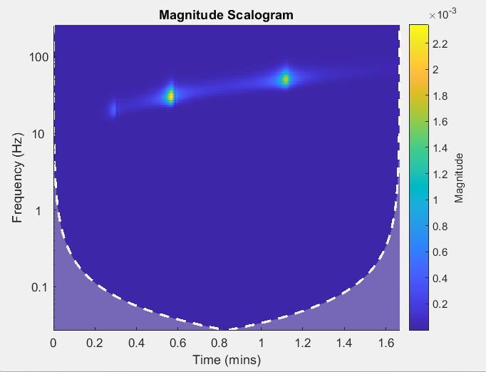
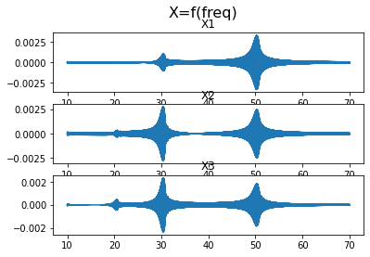
Add damping?

Slide 7
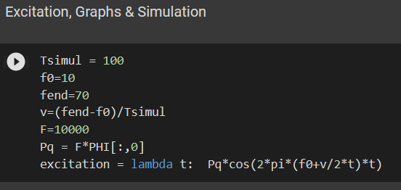
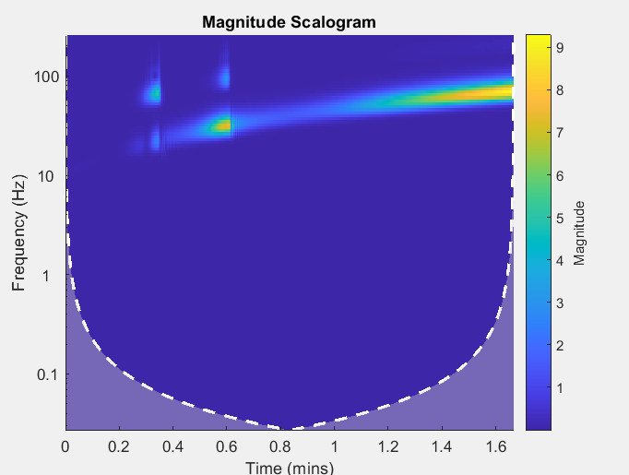
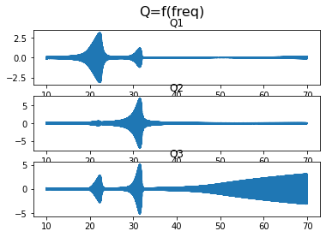
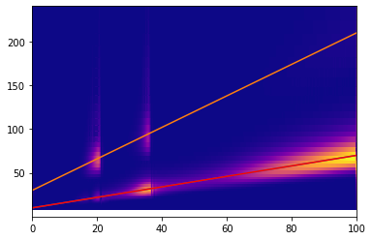
Increase F from 1 to 10,000

Slide 8
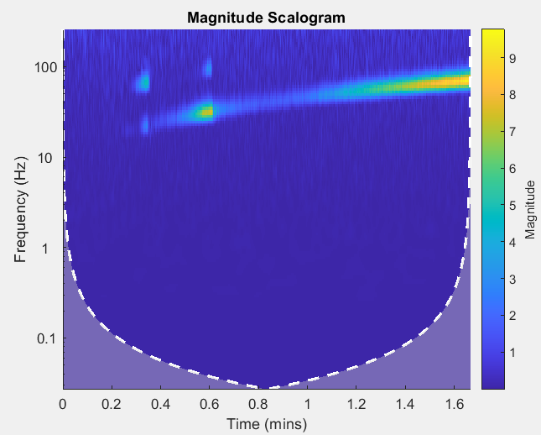
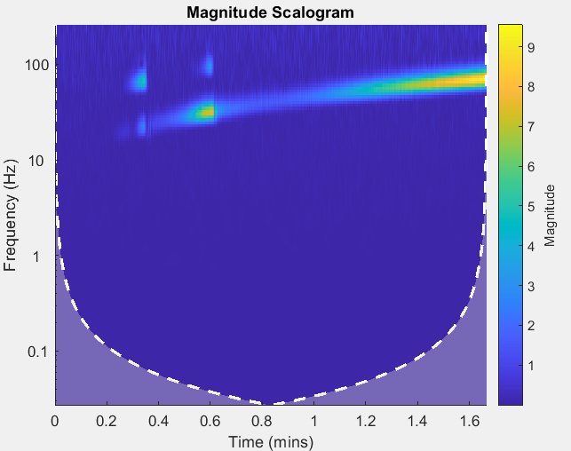
Adding Noise
noise_amp = 1 ;
noise_amp = 0,5 ;

Slide 9
Pre-processing wavelets
Extrapolation, Noise

Slide 10
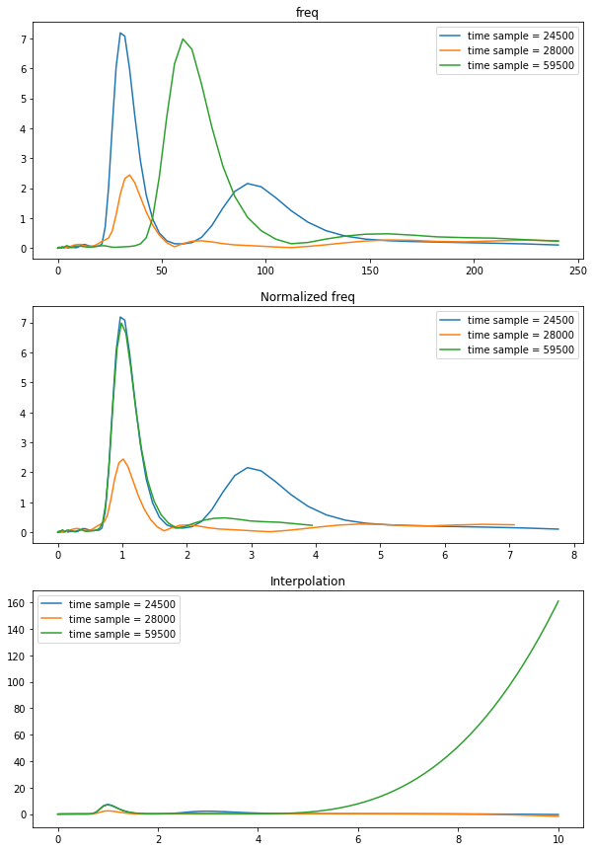
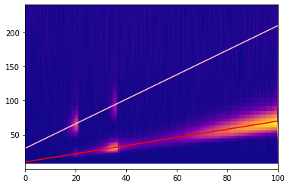
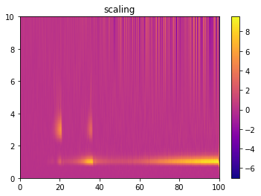
Preprocessing beam model + noise
Incoherences asypmtotically

Slide 11
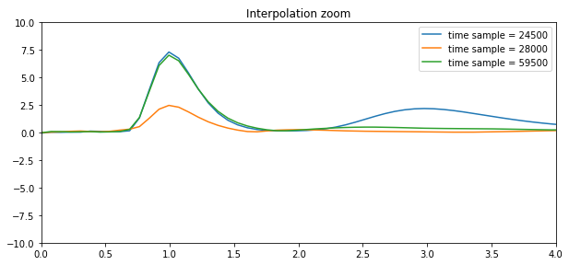
Extrapolation

Slide 12
Next steps?
1:2 modes
Classification of the wavelet transforms
Creating the training dataset

Slide 13
Next steps
We have:
Wavelet transforms for the 3 different models
Observable 1:3
We need:
Harmonics
1:2 modes?
Classify the existing wavelet transforms

